Slide 1
SLR(1) Parsing
1): S→ SS+ 2): S→ SS* 3): S→ a
According to the grammar of 4.2.1, answer the following questions:
Augment the grammar and construct the DFA of LR(0) items for the augmented grammar.
Is this augmented grammar the LR(0) or SLR(1) grammar ? Give your reason.
Construct the SLR(1) parsing table.
Show the parsing stack and the action of the parser for the input token string “aa+a*$”.

Slide 2
SLR(1) Parsing
LR(0) DFA
扩充文法 (argument grammar)
G:
S→SS+|SS*|a
G’:
S’→S
S→SS+|SS*|a

Slide 3
SLR(1) Parsing
G’:
S’→S
S→SS+|SS*|a
LR(0) DFA
S’→∙S

Slide 4
SLR(1) Parsing
G’:
S’→S
S→SS+|SS*|a
LR(0) DFA
I₀
S’→∙S
S→∙SS+
S→∙SS*
S→∙a

Slide 5
SLR(1) Parsing
G’:
S’→S
S→SS+|SS*|a
LR(0) DFA
I₁
S’→S∙
S→S∙S+
S→S∙S*
S→∙SS+
S→∙SS*
S→∙a
I₀
S’→∙S
S→∙SS+
S→∙SS*
S→∙a
S
a
I₂
S→a∙

Slide 6
SLR(1) Parsing
G’:
S’→S
S→SS+|SS*|a
LR(0) DFA
I₁
S’→S∙
S→S∙S+
S→S∙S*
S→∙SS+
S→∙SS*
S→∙a
I₃
S→SS ∙ +
S→SS ∙ *
S→S∙S+
S→S∙S*
S→∙SS+
S→∙SS*
S→∙a
I₀
S’→∙S
S→∙SS+
S→∙SS*
S→∙a
S
S
S
+
I₄
S→SS+∙
a
*
a
I₅
S→SS*∙
I₂
S→a∙
a

Slide 7
SLR(1) Parsing
G’:
S’→S
S→SS+|SS*|a
LR(0) DFA
状态I₁存在shift-reduce冲突,不是LR(0)文法
I₁
S’→S∙
S→S∙S+
S→S∙S*
S→∙SS+
S→∙SS*
S→∙a
I₃
S→SS ∙ +
S→SS ∙ *
S→S∙S+
S→S∙S*
S→∙SS+
S→∙SS*
S→∙a
I₀
S’→∙S
S→∙SS+
S→∙SS*
S→∙a
S
S
S
+
I₄
S→SS+∙
a
*
a
I₅
S→SS*∙
I₂
S→a∙
a

Slide 8
SLR(1) Parsing
The Main Idea of SRL(1)
It consults the input token before a shift to make sure that an appropriate DFA transition exists
It uses the Follow set of a nonterminal to decide if a reduction should be preformed.
For item A→r•, reduction only takes place when the next token a ∊ FOLLOW(A)
 | FOLLOW
S’ | $
S | $ , +, *, a
G’:
(0) S’→S
(1) S→SS+
(2) S→ SS*
(3) S→a
For state I₁
If the next token is ‘$’, then reduce
If the next token is ‘a’ , then shift
Conflict can be solved. So it is SLR(1) grammar.

Slide 9
Construction of SLR(1) Parse Table
Given a grammar G, we augment G to produce G’
Construct DFA of sets of LR(0) items
The ACTION section for state K is determined as follows:
If A→α•aβ∈K, a∈V_{T}, and goto(K,a)=J, then set ACTION[K,a]=‘S_{J}’
If A→α•∈K, and the number of A→α is j, then set ACTION[K,b]=R_{j} for each b∈Follow(A)
If S’→S•∈K, then set ACTION[K,$]=‘acc’
The GOTO section for state K is constructed for all nonterminals using the rule: If A→α•Bβ∈K, B∈V_{N}, and goto(K,B)=J, then set GOTO[K,B]=‘J’

Slide 10
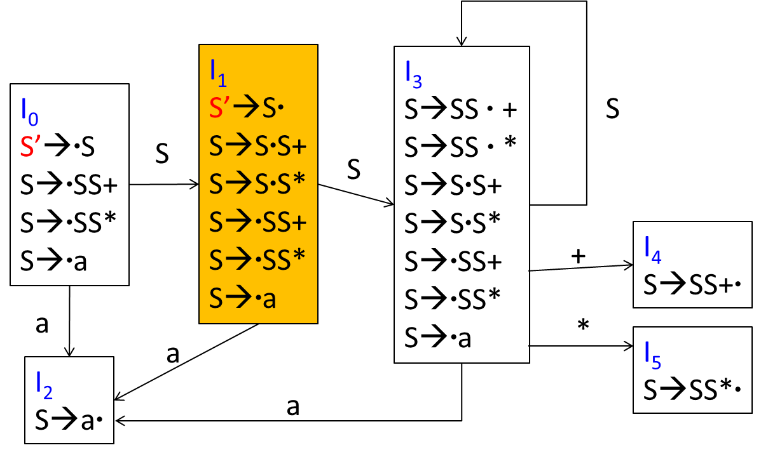
SLR(1) Parsing table
G’:
(0) S’→S
(1) S→SS+
(2) S→ SS*
(3) S→a
 | Action |  |  |  | Goto
 | a | + | * | $ | S
0 | s2 |  |  |  | 1
1 | s2 |  |  | acc | 3
2 | r3 | r3 | r3 | r3
3 | s2 | s4 | s5 |  | 3
4 | r1 | r1 | r1 | r1
5 | r2 | r2 | r2 | r2
 | FOLLOW
S’ | $
S | $ , +, *, a

Slide 11
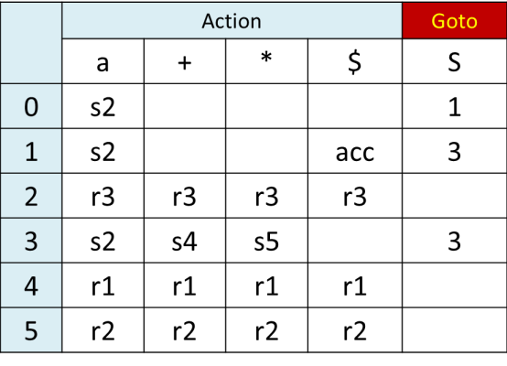
SLR(1) Parsing
G’:
(0) S’→S
(1) S→SS+
(2) S→ SS*
(3) S→a
SLR(1) 分析过程模拟
Step | Stack | Input | Action | Goto
1 | $0 | aa+a* $ | s2
2 | $0a2 | a+a* $ | r3 | 1
3 | $0S1 | a+a* $ | s2
4 | $0S1a2 | +a* $ | r3 | 3
5 | $0S1S3 | +a* $ | s4
6 | $0S1S3+4 | a* $ | r1 | 1
7 | $0S1 | a* $ | s2

Slide 12
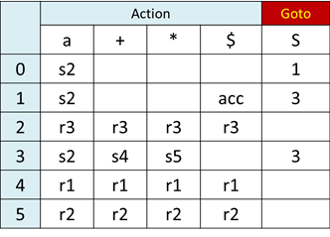
SLR(1) Parsing
SLR(1) 分析过程模拟
Step | Stack | Input | Action | Goto
8 | $0S1a2 | * $ | r3 | 3
9 | $0S1S3 | * $ | s5
10 | $0S1S3*5 | $ | r2 | 1
11 | $0S1 | $ | acc

